Slide 1

ACA App Action Plan

Slide 2
Book a music artist app. Mic is used in the sense, that any Musician, DJ, or Artist must pick up their microphone to be heard. The ‘Us’ comes from the phrase “Book Us Now”.
Mic.Us

Slide 3
The Goal
Local independent music artists, bands, or DJs can upload their best art in one search
Locals can find near, affordable talent, and book them for events, parties, weddings, etc.

Slide 4
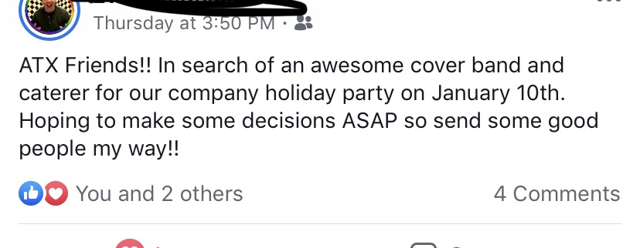
That’s what this app is all about: Finding Yourself and Promoting yourself! PROMOTE, PROMOTE, PROMOTE

Slide 5
APIs
Rest API – To Upload Files
A smartURL
Booking API
Google Play API – To Publish
iOS and Android
One day, YouTube API, Spotify API, Apple Music API, SoundCloud API

Slide 6

Market
Local Musicians, DJs, and Artists
Smaller Venue Managers
Anybody looking to book any kind of event.
Music Industry
Competition
Sonicbids – Electronic Press Kit
GigFaster, GigSalad, GigSmart,
Bandsurfing,
And ReverbNation.
No subscription and needs to be
beneficial for both parties.

Slide 7
Minimal Solution Set
Testers
Chris – Dolla512
Ema

Slide 8

See you all at Graduation
April 2020

